Slide 1
CSE-2103
Object-Oriented Programming
Lecture 1 - 1
₂nd
March, 2021

Slide 2
Basic Concept of Object-Oriented Programming (OOP)
Conducted by
Mehedi Hasan
Lecturer, Department of CSE

Slide 3
What is Object-Oriented Programming (OOP)
OOP is a programming paradigm based on the concept of 'objects'.
Objects contain data in the form of attributes and code in the form of methods.
It helps model real-world systems using classes and objects, improving modularity, reusability, and maintainability.

Slide 4
Key Features of OOP
1. Class: Blueprint for creating objects.
2. Object: Instance of a class.
3. Encapsulation: Binding data and methods.
4. Inheritance: Reuse properties of existing classes.
5. Polymorphism: One interface, many implementations.
6. Abstraction: Hiding complex details from the user.

Slide 5
What is Structure-Oriented Programming (SOP)
SOP focuses on procedures or routines (functions).
It separates data and functions.
Programs are organized as a set of functions and global data.

Slide 6
Comparison: OOP vs SOP
Aspect | OOP | SOP
Approach | Object-based | Function-based
Modularity | High (Classes & Objects) | Low (Functions only)
Data Security | Supports encapsulation | No encapsulation
Code Reusability | Via inheritance | Limited reuse
Real-world Modeling | Easy | Difficult

Slide 7
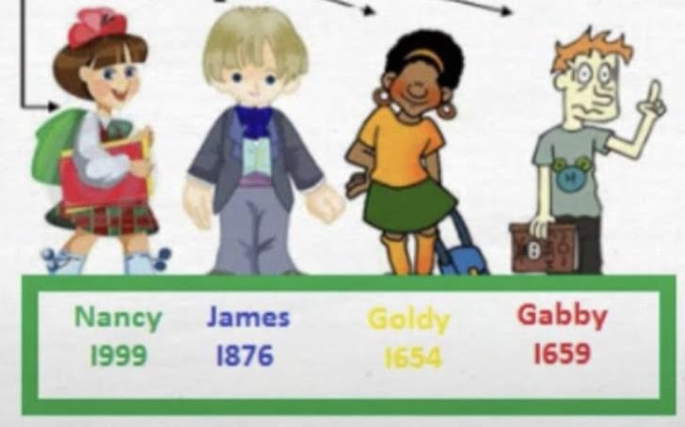
Object Oriented Programming (OOP)
Real-World Entity:
In Real-World every single entity is unique,
like…….
Every object have some attributes. (Data)
Also, performs some actions. (Functions)
Object:
The fundamental idea of OOP is to combine both data and functions into a single unit.
Such unit is called an object.
The functions of an object operates on these
data.
₂nd
March, 2021

Slide 8
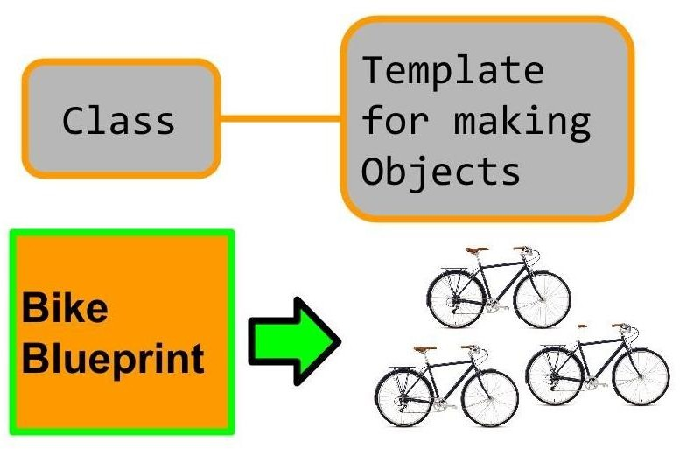
Object Oriented Programming (OOP)
Class:
Class is the building block of OOP.
It is a user-defined data type, which holds its own data members and member functions, which can be accessed and used by creating an instance of that class.
A class is like a blueprint for an object.
An Object is an instance of a Class.
When a class is defined, no memory is allocated but when it is instantiated (i.e. an object is created) memory is allocated.
₂nd
March, 2021

Slide 9
Object Oriented Programming (OOP)
Data Encapsulation:
Binding (or wrapping) code and data together into a single unit is known as encapsulation.
Data encapsulation is a key term of OOP.
Outside world can’t access data of an object directly.
Data of an Object only can be accessed by using its member function.
Data is hidden, so it is safe from accidental use and alteration.
₂nd
March, 2021

Slide 10
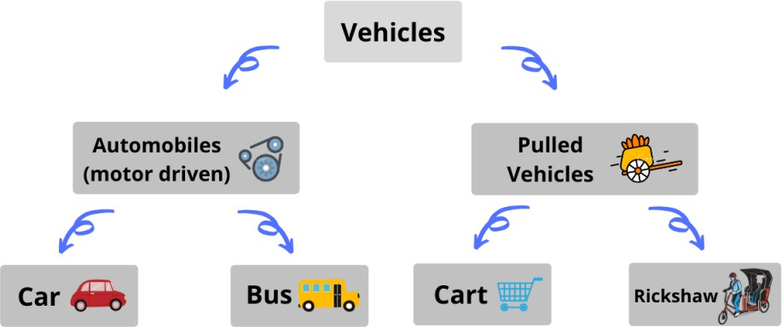
Object Oriented Programming (OOP)
Inheritance:
Inheritance is one of the most important feature of Object Oriented Programming.
It allows to create a new class (derived class) from an existing class (base class).
The derived class gets all the features from the base class and can have additional features.
Inheritance is an is-a relationship. We use inheritance only if an is-a relationship is present
between the two classes.
- A car is a vehicle. - Orange is a fruit. - A surgeon is a doctor. - A dog is an animal.
₂nd
March, 2021

Slide 11
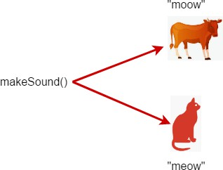
Object Oriented Programming (OOP)
Polymorphism and Overloading:
Polymorphism means many forms.
In C++, polymorphism causes a member function to behave differently based on the object that calls/invokes it.
₂nd
March, 2021

Slide 12
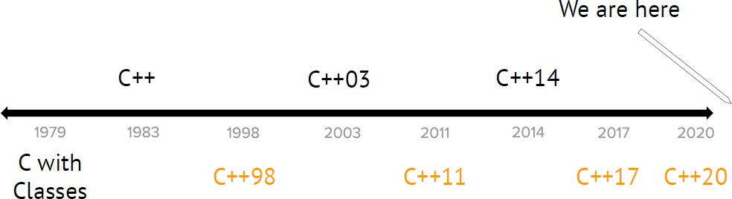
C++ History: Evolution of C++
₂nd
March, 2021

Slide 13
Basic Syntax of C++
#include <iostream> // Preprocessor directive
using namespace std; // Use standard namespace
int main() { // Main function
cout << "Hello, World!"; // Output statement
return 0; // End of program
}

Slide 14
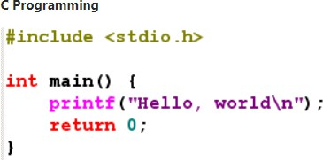
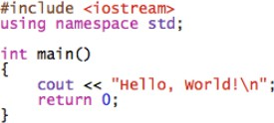
Program Syntax
Lecture 2 - 3
₉th
March, 2021

Slide 15
Console I/O
printf(“Text to display.”);
scanf(“%d”, &a);
cout << “Text to display.”;
cin >> a;
Lecture 2 - 4
₉th
March, 2021

Slide 16
Explanation of C++ Syntax
#include <iostream>: Includes the standard input-output stream library.
using namespace std;: Avoids writing 'std::' before standard functions.
int main(): Entry point of every C++ program.
cout: Used to print output to the console.
return 0;: Indicates that the program ended successfully.

Slide 17
Summary
OOP helps in building scalable and maintainable applications.
It reflects real-world behavior more naturally than SOP.
Encapsulation, inheritance, and polymorphism make OOP more powerful.
SOP is simple but less suitable for complex systems.

